Slide 1

HOTEL MANAGEMENT SYSTEM

Slide 2
Team Members
Shivam Dadarao Mandade
Shivam Ramesh Sharma
Madaka Nagendra
Gaurav Pradip Shinde
DhanaLakshmi Veeranki
Vasundhara Chundu

Slide 3
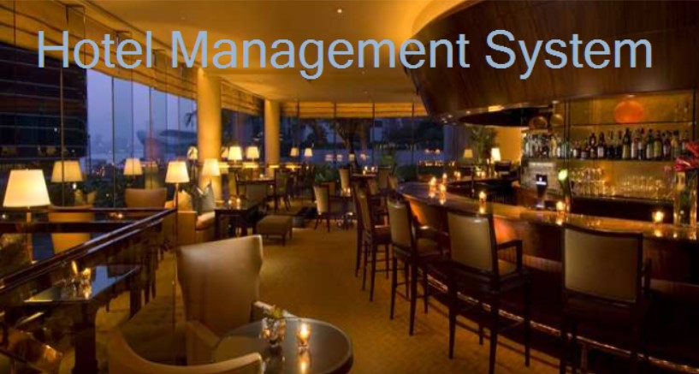
Introduction
Handle management processes.
Search Hotels.
Ease to check Rooms.
Client Communication and Data Management.

Slide 4

Technologies Used
Visual Studio 2019
SQL Server 2014 Management Studio
ADO.Net

Slide 5
OBJECTIVES
Automate the management process for the Hotel.
Display Cities where booking are available.
Sort and display the details of Hotel.

Slide 6
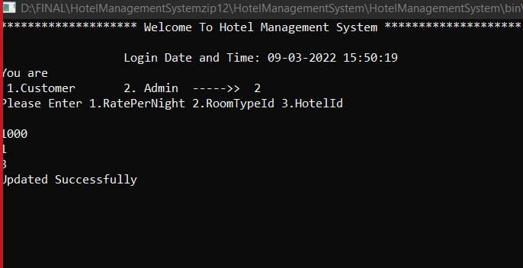
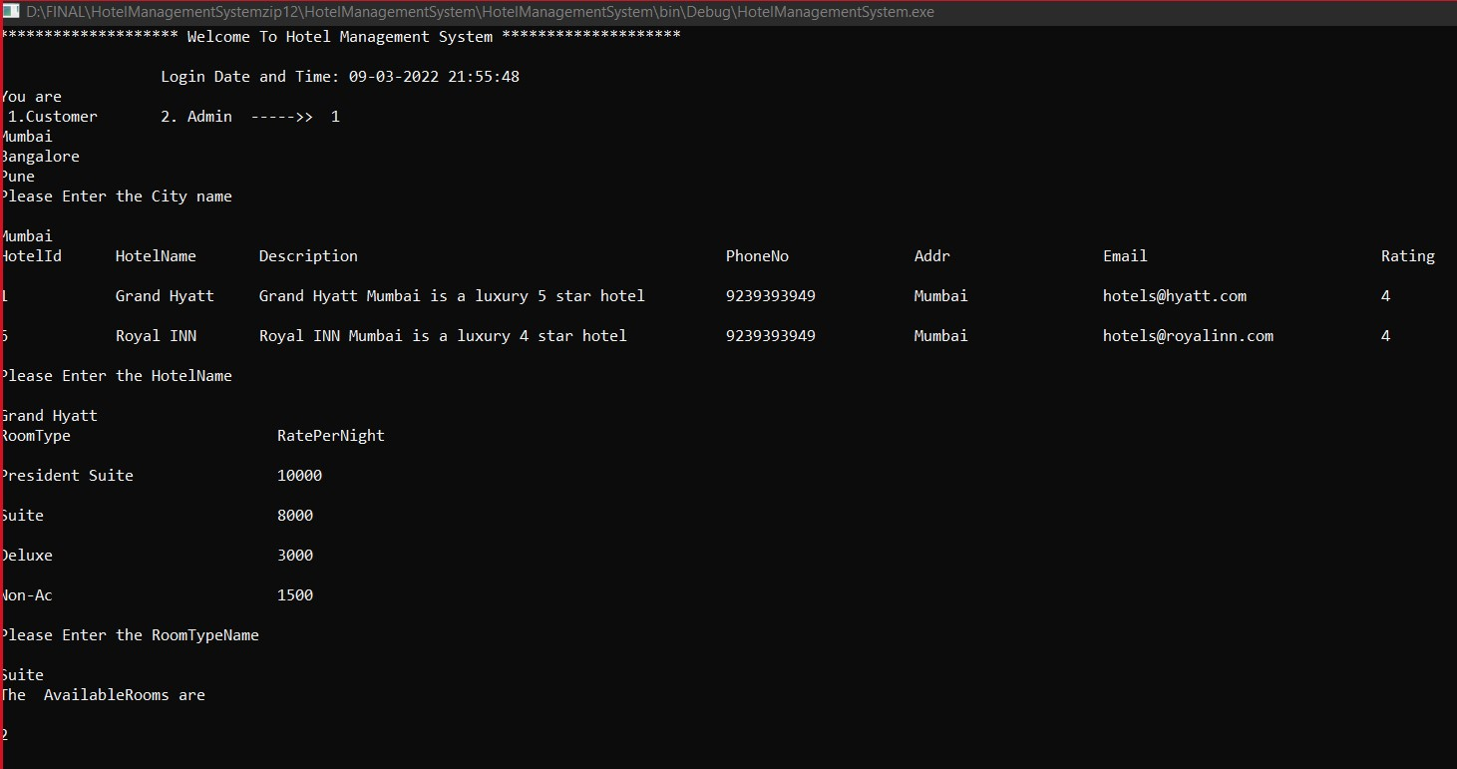
Results

Slide 7
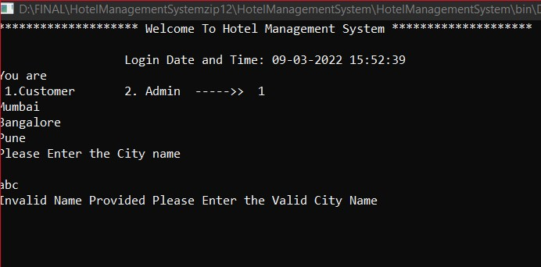
Results

Slide 8
Advantages
Saves Time.
User Friendly.
Centralized Data.
Secured Data.
Effective Customer Management System.

Slide 9
Summary
A Hotel Management System is a computerized management system keeping the record of the hardware assets besides software of this organization.
Automates the conventional process.

Slide 10


